Slide 1
Self-driving Cars, Internet of Vehicles
Josh Howard

Slide 2
What are self driving cars?
Levels of automation
Level 0 – No automation
Level 1 – Driver Assistance
Level 2 - Partial Automation
Level 3 - Conditional Automation
Level 4 - High Automation
Level 5 - Full Automation

Slide 3
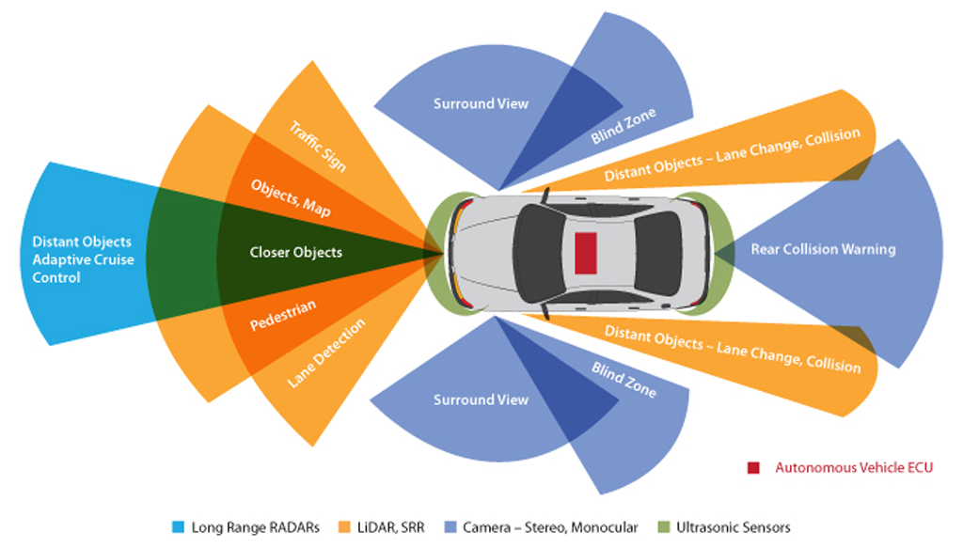
How do they work?
Radar – Calculate distance
Cameras – View the area around the car
LiDAR – Builds a map of the world around you
Sensors

Slide 4

What does this look like to a car?

Slide 5
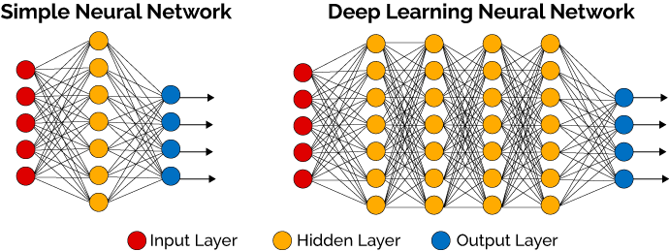
How is this achieved?

Slide 6
Internet of Vehicles (IoV)
What is this?
Why is it needed?
How do Self Driving Cars use this?

Slide 7
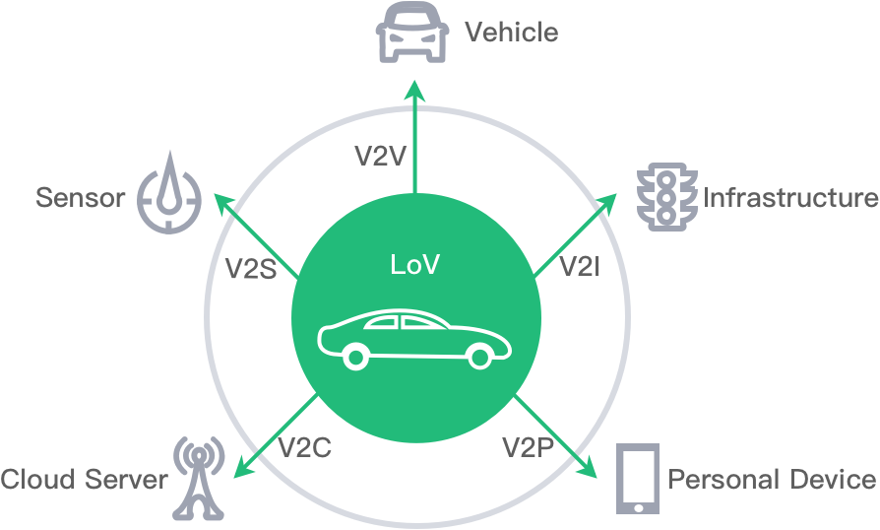
What is the Internet of Vehicles?
Interconnected network of road transports
V2V(Vehicle-to-Vehicle)
V2R(Vehicle-to-Road)
V2H(Vehicle-to-Human)
V2S(Vehicle-to-Sensor)

Slide 8
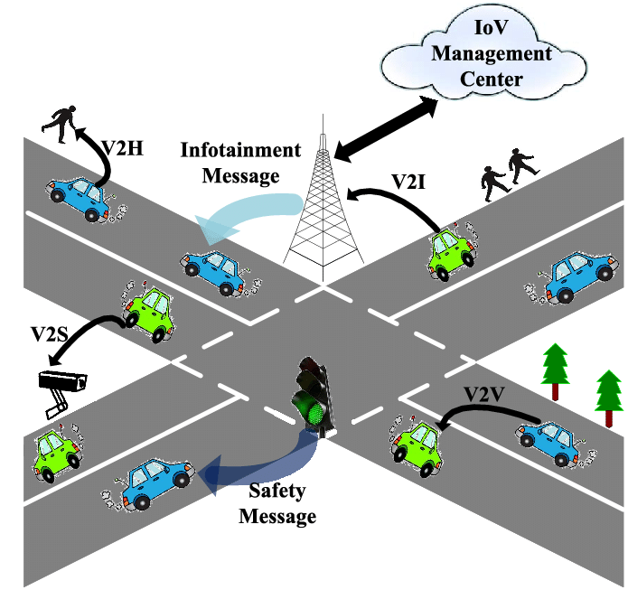
Why is this needed?
Road safety.
Communication between all entities.
Response and Alerts

Slide 9

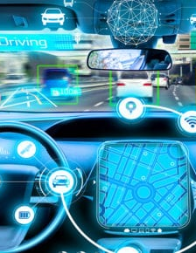
Self Driving Cars and IoV
Accurate data
Current traffic
Possible hazards
Looking out for other cars

Slide 10
References
https://www.nvidia.com/en-us/self-driving-cars/drive-platform/
https://www.nvidia.com/en-us/self-driving-cars/
https://www.techradar.com/news/driverless-cars-explained
https://www.youtube.com/watch?v=0rc4RqYLtEU
https://www.caranddriver.com/features/a15079828/autonomous-self-driving-car-levels-car-levels/
https://www.youtube.com/watch?v=0rc4RqYLtEU
https://www.nvidia.com/en-us/self-driving-cars/drive-platform/
https://www.wired.com/story/the-know-it-alls-how-do-self-driving-cars-see/
https://towardsdatascience.com/mnist-vs-mnist-how-i-was-able-to-speed-up-my-deep-learning-11c0787e6935
https://blogs.nvidia.com/blog/2015/02/19/deep-learning-2/
https://www.youtube.com/watch?v=booEg6iGNyo

Slide 11
References
https://www.fpt-software.com/automotive-tech-blog/internet-of-vehicles-iov-and-its-applications/
https://medium.com/the-research-nest/internet-of-vehicles-explained-what-is-it-and-why-is-it-important-3d3fd72038ff

